Slide 1


“SHADOW SENSOR ALARM”
BY
ANAND T - 1NH17EC006
Under the Guidance of
Ms.Divya Sharma
Department of ECE
NHCE

Slide 2
INTRODUCTION
This is the circuit of a simple burglar alarm that produces a loud beep when somebody crosses a protected area or door.
The circuit is highly sensitive and can detect the shadow of the moving person from a distance of 1 meter.
It does not require an aligned light beam to make the circuit standby. It is portable and can be places anywhere for monitoring.
When light falls on LDR its resistance reduces to a few ohms. Thus the resistance of LDR depends on the light intensity. So it is called as a photo sensor.

Slide 3
OBJECTIVES
Operational amplifiers are Integrated Circuits(IC) that are used in amplifier circuits.
The objective is to sense the shadow falling on the circuit.
To understand the operation of operational amplifier .
To use the designed circuit in a practical situation .

Slide 4
LIST OF COMPONENTS NEEDED
To implement this project, we need the following components.
1 x 555 Timer IC
1 x LDR
1 x Piezo Buzzer
1 x 10 KΩ Resistor (1/4 Watt)
1 x 2.2 KΩ Resistor (1/4 Watt)
1 x 1 MΩ Resistor (1/4 Watt)
1 x 1 µF Electrolytic Capacitor (50V)
1 x 0.1 nF Ceramic Capacitor (Also called 100 pF with code 101)
1 x 9V Battery
1 x Mini Breadboard
Jumper Wires

Slide 5
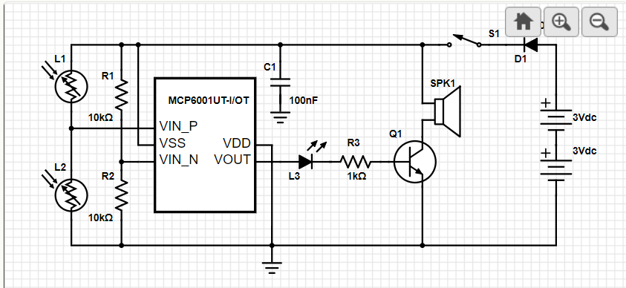
Block diagram

Slide 6
Working Principle:
Op Amp IC UA 741 is used as a voltage comparator.
Its inverting input pin2 receives half supply voltage (4.5 volts) through the potential resistors R1 and R2.
The non inverting input pin3 gets a variable voltage through LDR and VR.
Normally when the LDR gets light, its resistance will be low and it conducts and provide a high voltage to the non inverting input of IC.
This makes the output of IC high. The high output from IC is given to the base of T1 through a current limiting resistor R3.
T1 is PNP transistor and it conducts only when its base becomes negative.
Here normally the base of T1 will be high due to the high output from IC. So T1 remains off and Buzzer and LED connected to its emitter remains off.
When a person passes in front of LDR, the shadow of the person reduces the resistance of LDR and the voltage at the non inverting input of IC decreases.
This makes the output of IC low. Immediately T1 conducts activating Buzzer and LED indicating the entry of a person.

Slide 7
MILE STONES
We have understood the working of the circuit clearly .
We have designed the block diagram .
We have the circuit diagram according to the block diagram .
We have the list of components .
Purchasing of components – before 15th march
Implementation -- before 25th
Out put will be ready by the commencement of the april.

